Slide 1
Financial Markets and
Beauty Contest Game in the Lab
Rosemarie Nagel
(UPF-ICREA-BGSE)
Bojos February 2025

Slide 2
What is economics?
Economic models of (human) behavior, activity
  Prediction, prescriptions, quantifying measures
  Different kind of agents: firms, households, state, banks etc.
  Macro: Aggregations of agent activity (inflation, taxes etc.)
  Micro: individual activity (e.g. monopoly, oligopoly)
  Coordination, exchange, scarcity, social norms, money
    With or without prices as coordination devices
  Implications for the real world
  Tools: game theory, statistics, econometrics
  Natural data (e.g. bank data on saving) or data creation (lab or field)
  Rationality on aggregate level stronger than on individual level

Slide 3
My current view on research
Logic (theory-consistency)
Other social or natural sciences,
Humanities
Natural data
Economics
Game theory
Tools: preferences, equilibrium
Simulations
Mind (software)
(human behavior & cognition, subjective)
Lab-Field experiments (ex
Nature (hardware)
(body & brain
objective)
Experimental Economics
Behavioral Economics
Psychology (tests), Ethics
Tools: Creating behavioral data
Simulations, Computer
LAB & FIELDEXPERIMENTS
Neurosciencs
Biology
Tools: eye-trackers, fmRI etc
Real world – Policy Implication
e.g. Central Banks,
Environmental issues,
Development
Computational tools, statistics,
Econometrics etc.

Slide 4
Let’s do an experiment

Slide 5
Rules of the original Beauty Contest game
Choose a number between 0 and 100. The winner is the person whose number is closest to 2/3 times the average of all chosen numbers.
The winner will get 5 Euros, split when tied.
Notes:
Here one can have both 2 player groups and more than two player groups. That is each person gets a slip of paper in which it is specified how many others also player: “You are in a group of 2 (10) players including yourself. Choose a number between 0 and 100. The winner is the person whose number is closest to 2/3 times the average of the 2 (10) chosen numbers in your group.

Slide 6
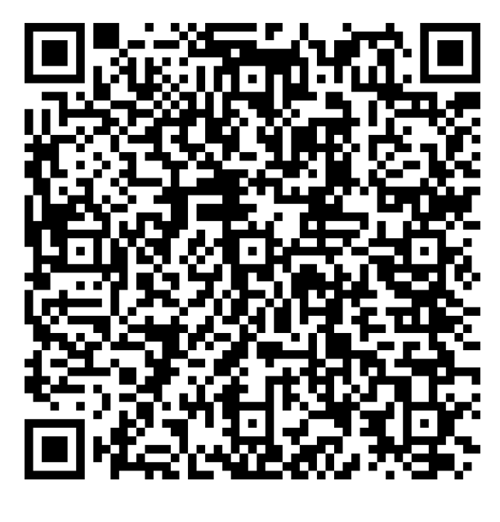
go to: https://classex.uni-passau.de
choose: Universitat Pompeu Fabra
choose: Rosemarie Nagel
choose: participant
enter password: experiment

Slide 7
Rules, theories, and data for the basic game
Rules
Choose a number between 0 and 100. The winner is the person whose number is closest to 2/3 times the average of all chosen numbers
Main problem: starting point=level 0

Slide 8
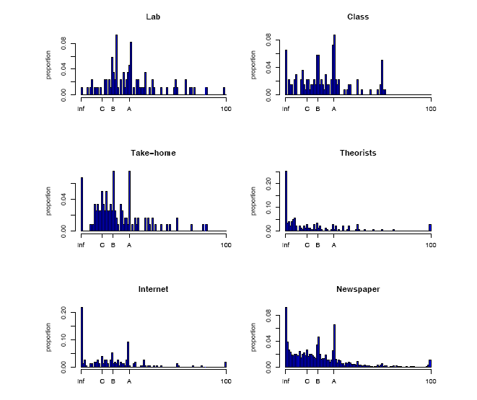
Bosch, Montalvo,Nagel, Satorra , AER 2002
MEAN 35.13
MEAN 28.54
C=level 3 (15=50*2/3*2/3*2/3)
B=level 2 (22=50*2/3*2/3))
A=level 1
(33=50*2/3))
MEAN 25.20
MEAN 17.15
MEAN: 22.16
MEAN 23.08

Slide 9
P=4/3
3 PLAYERS, P=2/3
P=2/3
P=1/2-median game
Nagel 1995, Camerer, Ho AER 1998)

Slide 10
Beauty Contest Game
Or, to change the metaphor slightly, professional investment may be likened to those newspaper competitions in which the competitors have to pick out the six prettiest faces from a hundred photographs, the prize being awarded to the competitor whose choice most nearly corresponds to the average preferences of the competitors as a whole; so that each competitor has to pick not those faces which he himself finds prettiest, but those which he thinks likeliest to catch the fancy of the other competitors, all of whom are looking at the problem from the same point of view. It is not a case of choosing those which, to the best of one’s judgment, are really the prettiest, nor even those which average opinion genuinely thinks the prettiest. We have reached the third degree where we devote our intelligences to anticipating what average opinion expects the average opinion to be. And there are some, I believe, who practise the fourth, fifth and higher degrees.
Keynes (1936, p. 156)

Slide 11
What does it mean for the real world?
When there is low rationality economic outcomes look different from the rational model
Different policy implications

Slide 12
Economics
Psychology
Behavioral Economics, Experimental Economics
+
Neuroscience
=
Neuroeconomics

Slide 13
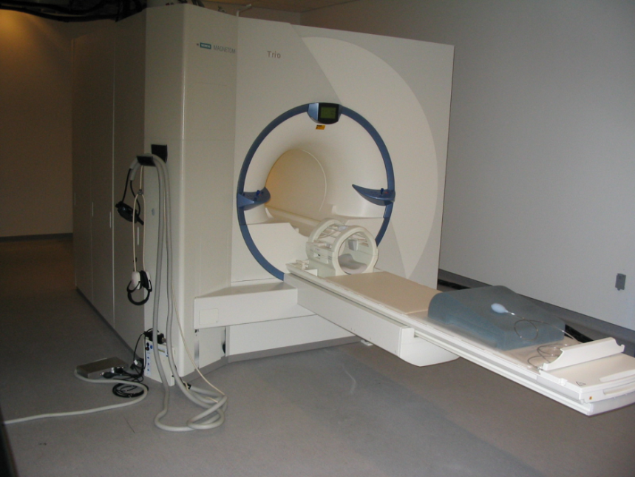
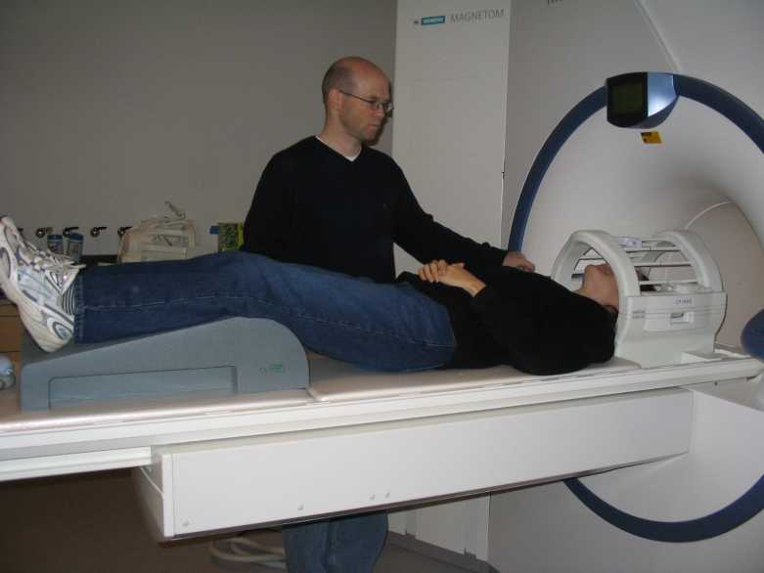
Example of MRI scanner
  Scanner
  a very powerful electro-magnet
  field strength of 3 teslas (T), ~60,000 times greater than the Earth’s field
During the experiment:
  subject lies in the scanner and is exposed to the stimuli
  scanner tracks the signal throughout the brain
Notes:
13

Slide 14
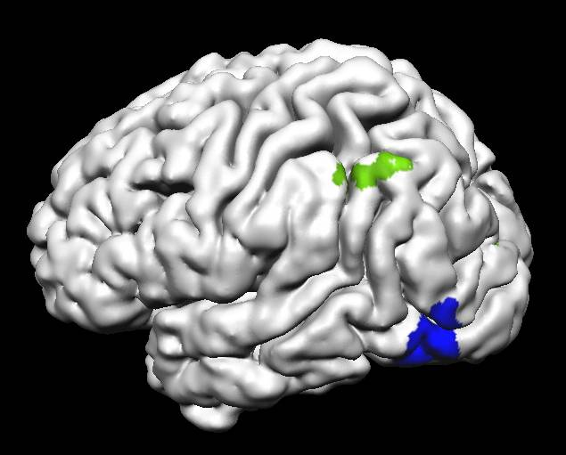
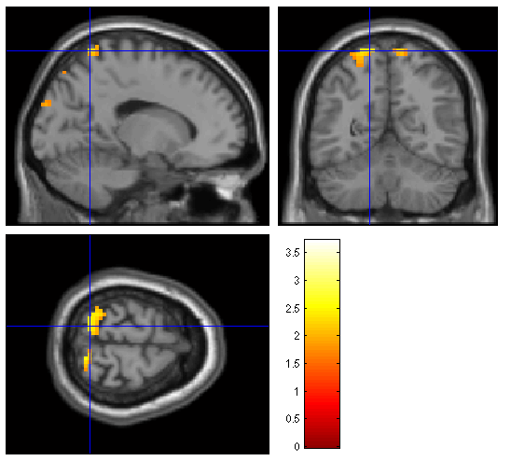
Nature of fMRI activation
When a brain area is more active it consumes more oxygen
Changes in blood flow and blood oxygenation in the brain are indirect measures of neural activity
(Blood Oxygenation Level Dependent (BOLD) signal)
increasing
increasing
increasing
Neural activity
Blood oxygen
fMRI signal
Data is usually transformed into “activation” maps
Activation maps show which parts of the brain are involved in a particular mental process

Slide 15
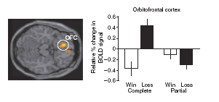
Objective of design: Link between stimulus (model, rules),
behavior, biological data (e.g. brain activity), to find out thought processes
Stimulus
}
Behavior
e.g. inside scanner
Economic/behavioral models
e.g.
expected utility
risk aversion
risk loving
regret models
Adapted from Camerer et al. 2010

Slide 16
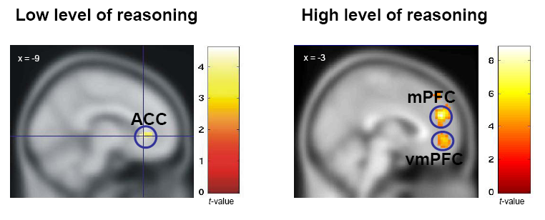
High vs. low level of reasoning
N = 10
N = 7
“CHOOSING 33” “CHOOSING 22”
Coricelli Nagel (PNAS 2009)

Slide 17
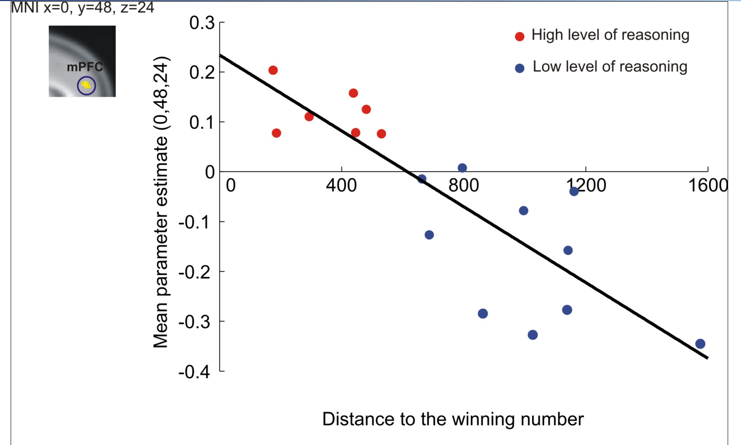

Slide 18
Watch the movie on the game
see here and goto Netflix in case you have it:
Watch Alice in Borderland | Netflix Official Site
sequence 2 (of 2) chapter 6, starts at about minute 30. You have to select Season 2.
Have fun. It is about 20 minutes, also connecting it to Organ transplantation.

Slide 19
Financial markets

Slide 20
Definition
“A bubble may be defined loosely as a sharp rise the price of an asset …, with the initial rise generating expectations of further rises and attracting new buyers – generally speculators interested in profits from trading in the asset rather than its use or earning capacity.”
-- Charles Kindleberger, The New Palgrave

Slide 21
Can bubbles persist?
Keynes (1936)
“It might have been supposed that competition between expert professionals, possessing judgment and knowledge beyond that of the average private investor, would correct the vagaries of the ignorant individual left to himself.”
Fama (1965)
“If there are many sophisticated traders in the market, they may cause these “bubbles” to burst before they really get under way.”

Slide 22
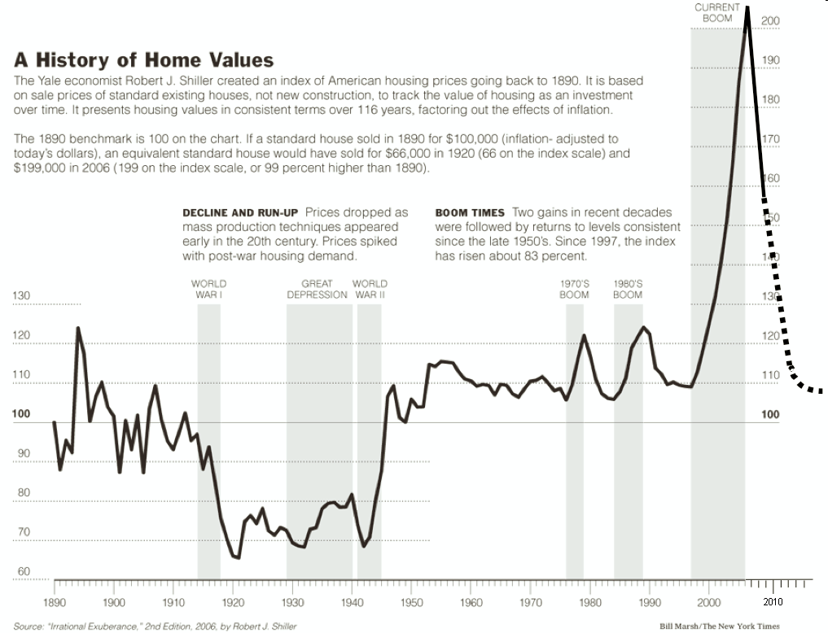

Slide 23
Why a lab experiment?
Too many unknowns in the real world
Control of important variables: Here:
  Fundamental values (at least known to the experimenter)
  Borrowing constraints are the same for all
  Time horizon the same for all
  Experience level of subjects can be made the same (repetition of the same market)
  Controlled centralized market: here call market
  Control of reason to buy/sell. In contrast e.g. in housing market, need for a house

Slide 24
What should you bid
If all were perfectly rational?
P*i=D why?
What to bid when you know that the others are not understanding the theory?

Slide 25
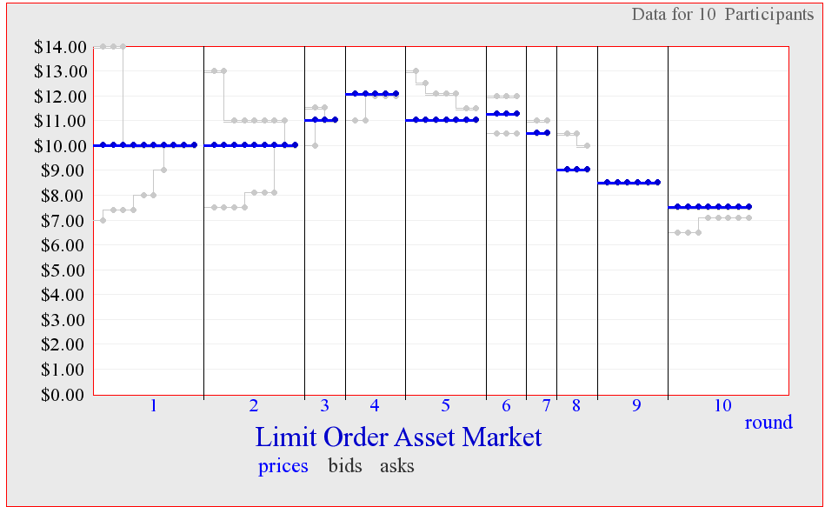
Are you different from others?

Slide 26
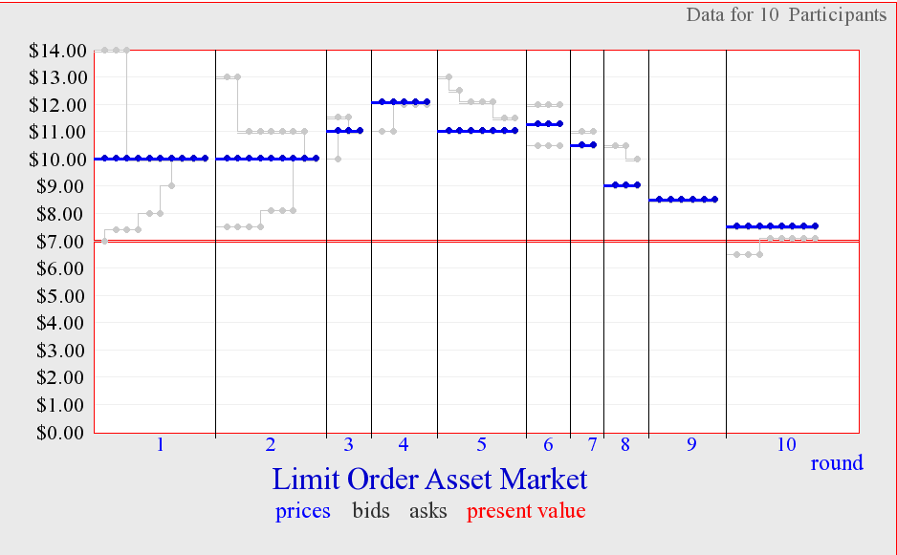

Slide 27
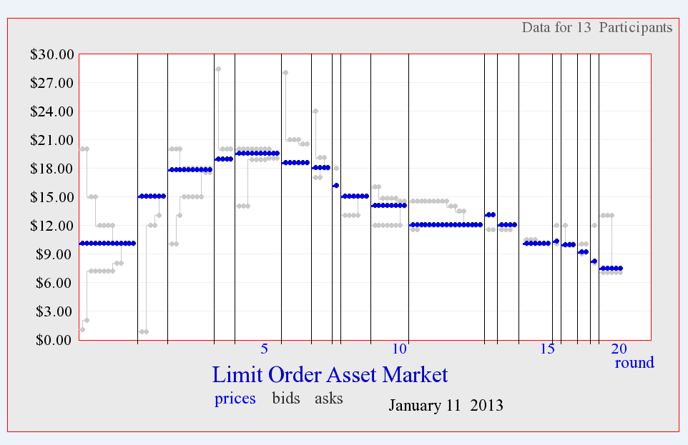

Slide 28
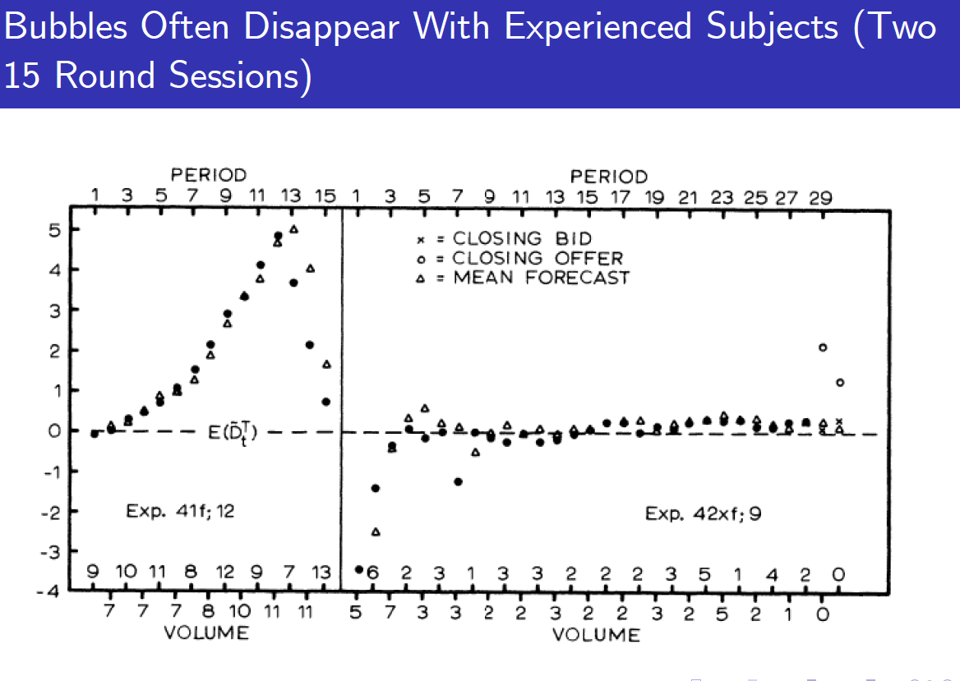

Slide 29
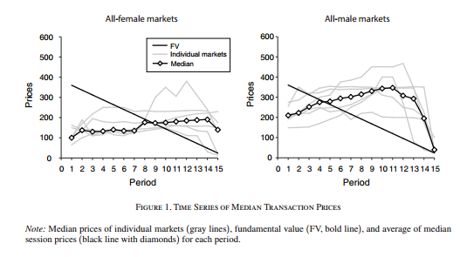

Slide 30
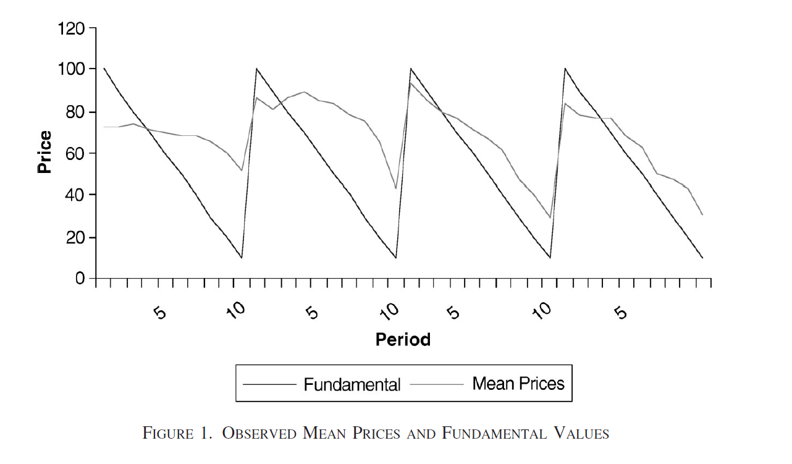
Dufwenberg et al. AER 2005
6 subjects play 10 periods of one market game;
the same market game with the same subjects is repeated again twice
In the fourth game 2 or 4 subjects are replaced by inexperienced subjects
Design:
2 or 4 new subjects
Replacing old subjects

Slide 31
Another neuro economics study with financial markets creating bubbles
Question:
Brain of those who win vs those who loose

Slide 32
-20
-10
0
10
20
Rounds after peak

Slide 33
Market Prices, 16 Sessions

Slide 34
Discussion: Insula
We find evidence for a neural “early warning” signal in the right anterior insula
Insula activity associated with awareness of bodily states, pain, risk, gut feelings & emotion
Suggests causal changes that increase insula activity could reduce bubbles

Slide 35
Conclusion
We can do experiments in economics
Create real world phenomena in the lab
Discuss actional behavior vs rational behavior

